Slide 1

DR. B. R. AMBEDKAR NATIONAL INSTITUTE OF TECHNOLOGY JALANDHAR-144008, PUNJAB (INDIA)
DEPARTMENT OF COMPUTER SCIENCE AND ENGINEERING
DMA Mini Project
Presentation on
Analyzing Student Financial Habits: A Data Mining Approach
Presented By:
Manav Malhotra - 23103086
Pramod -23103109

Slide 2
Introduction
Understanding student financial literacy is crucial for fostering healthy financial habits early in life. This project utilizes a comprehensive dataset to dissect student financial behaviors.
Our primary objective is to analyze student finance data to identify prevalent spending patterns, evaluate the effectiveness of budgeting, and uncover the critical factors influencing month-end savings.

Slide 3
Problem Statement
Key Questions Guiding Our Analysis:
What are the primary drivers influencing student spending decisions?
Does budgeting significantly impact saving habits compared to non-budgeting approaches?
Are there discernible differences in spending patterns based on gender?
Which financial variables exhibit the strongest correlation with month-end savings?

Slide 4




Our Approach
Data Collection & Import
Data Preprocessing & Cleaning
Gathering and integrating raw financial data.
Refining data for accuracy and consistency.
Exploratory Data Analysis (EDA) & Visualization
Pattern Identification & Conclusion
Extracting meaningful patterns and drawing conclusions.
Discovering insights and presenting data visually.

Slide 5
Tools and Technologies
Programming Language
1
R was utilized for all data manipulation, analysis, and visualization tasks.
Tidyverse
2
A collection of R packages, including ggplot2 for advanced visualizations and dplyr for efficient data wrangling.
Corrplot
3
Specifically used for generating visually informative correlation heatmaps.
GridExtra
4
Enabled flexible arrangement of multiple plots on a single canvas for comprehensive insights.

Slide 6

Dataset Overview: Student Financial Habits
Features (Input Variables):
The student_finance_dataset provided a rich source of information for our analysis, encompassing various aspects of student financial life.
Demographics: Age, Gender
Income: Monthly_Allowance, PartTime_Income
Spending Categories: Food_Expenses, Transport_Expenses, Accommodation_Expenses, Entertainment_Expenses, Shopping_Expenses
Initial State: The raw dataset presented challenges, including numerous missing values and inconsistencies, which necessitated rigorous cleaning prior to analysis.
Target Variables:
Budgeting Behavior: Budget (Yes/No)
Financial Outcome: Month_End_Leftover

Slide 7
Data Preprocessing Pipeline
1
Missing Value Imputation
N/A values in numerical columns like PartTime_Income were imputed using the respective column means to maintain data integrity and prevent analytical bias.
2
Outlier Removal
The Interquartile Range (IQR) method was applied to identify and mitigate the impact of extreme values in critical columns such as Monthly_Allowance, ensuring robust statistical analysis.
3
Categorical Encoding
Non-numerical variables like Gender and Budget were transformed into binary numerical formats (0/1) to facilitate compatibility with quantitative analysis methods.
4
Normalization
Key numerical features, including Age and Monthly_Allowance, were scaled to a uniform 0-1 range. This step is crucial for preparing data for certain machine learning models.

Slide 8
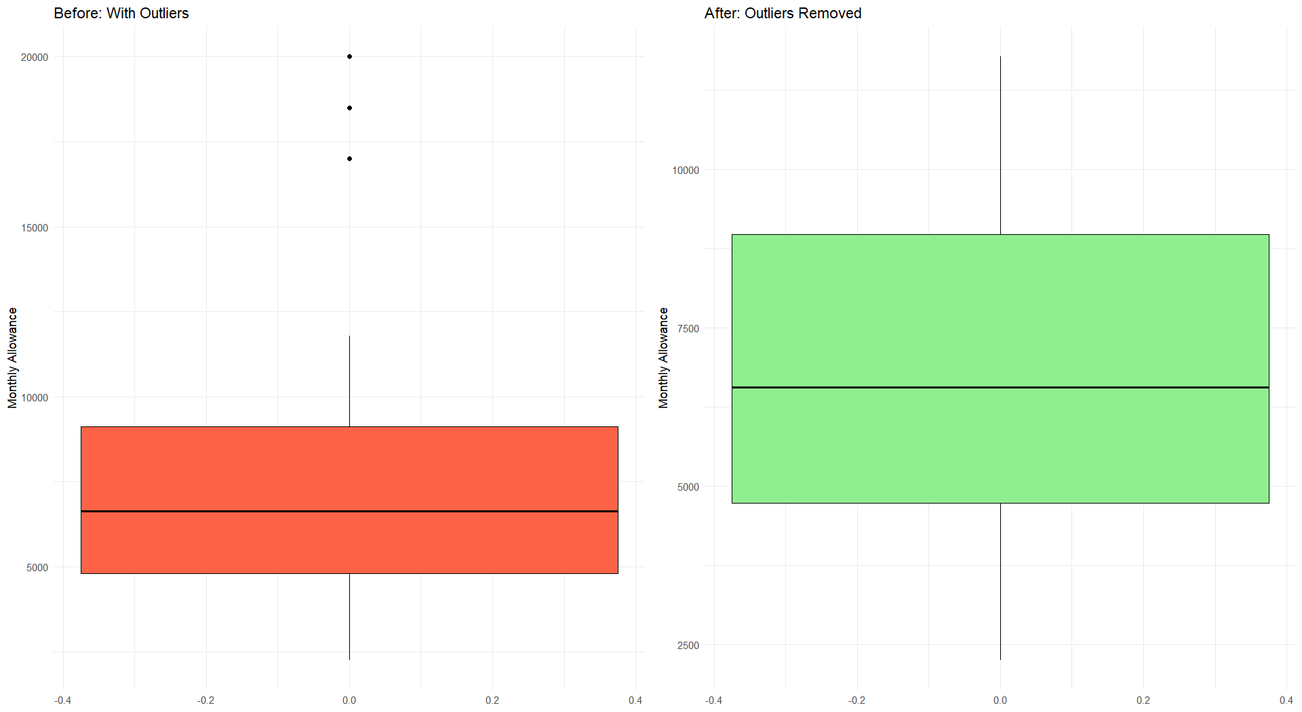
Removing Outliers
1

Slide 9
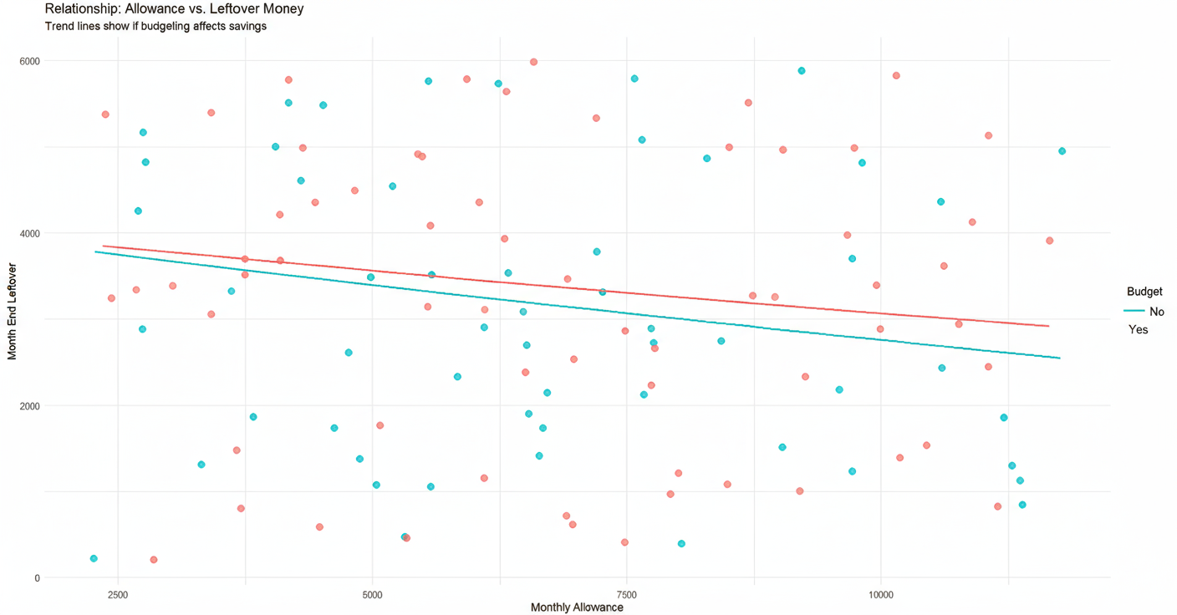
Visualization & Key Findings (I)
1
2
Finding 1: The Impact of Budgeting
This suggests that regardless of income level, engaging in budgeting practices is a highly effective strategy for improving financial outcomes and accumulating savings.
Our analysis reveals a compelling trend: students who actively budget (represented by "Yes") consistently demonstrate a significantly stronger positive correlation between their allowance and their month-end savings.
This scatter plot illustrates the relationship between monthly allowance and month-end savings, with data points differentiated by budgeting status.

Slide 10
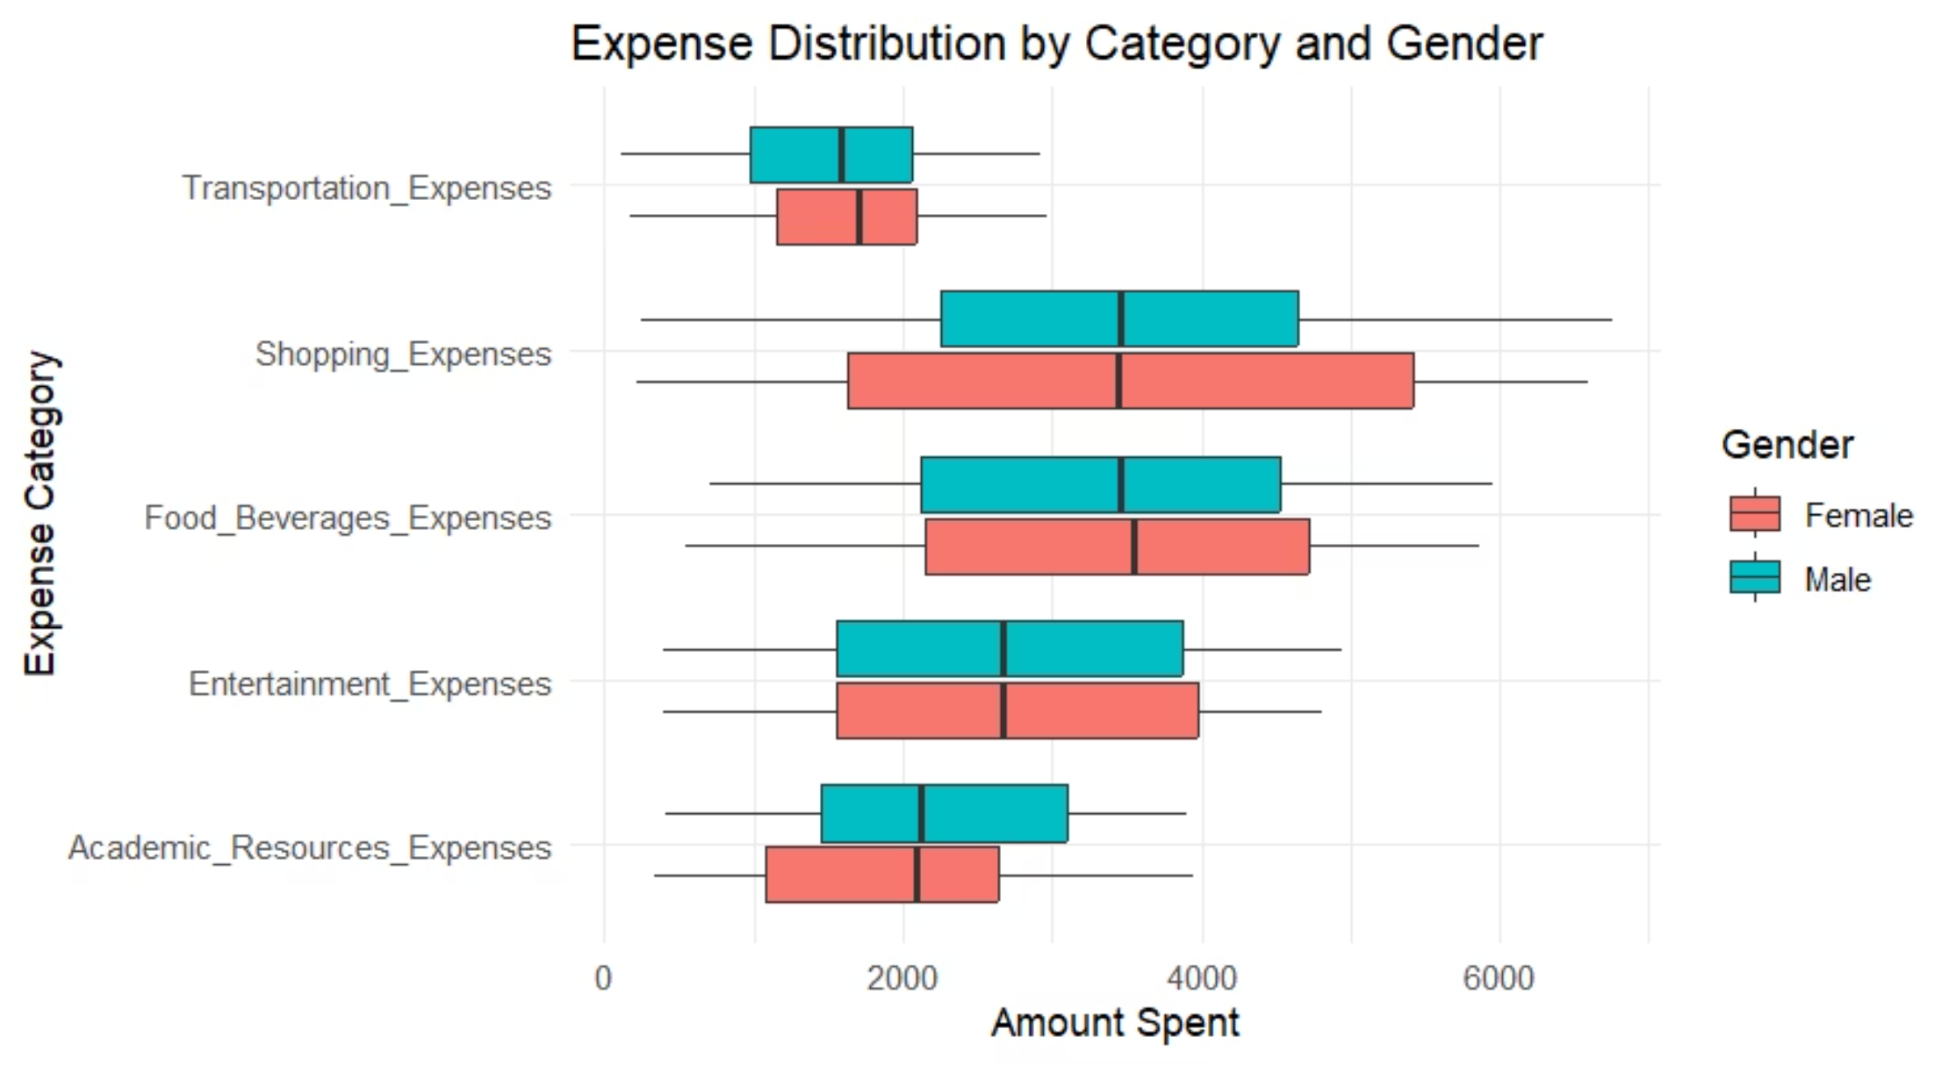
Visualizations & Key Findings (II)
Finding 2: Spending Patterns & Correlations
Expense Breakdown by Gender
A boxplot analysis of expense categories reveals that Food and Shopping consistently represent the highest spending areas for students across both genders. While there are minor variations, these two categories dominate student expenditure.
1

Slide 11
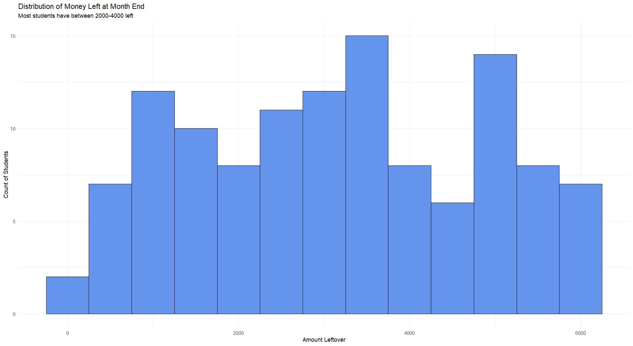
Visualizations & Key Findings (III)
Histogram analysis reveals that the majority of students successfully manage to save between 2,000 and 4,000 currency units by month-end. This observation establishes a crucial baseline for what can be considered "normal" saving behavior among the student population, indicating that both extreme savers and heavy spenders are relatively less common within this dataset.

Slide 12
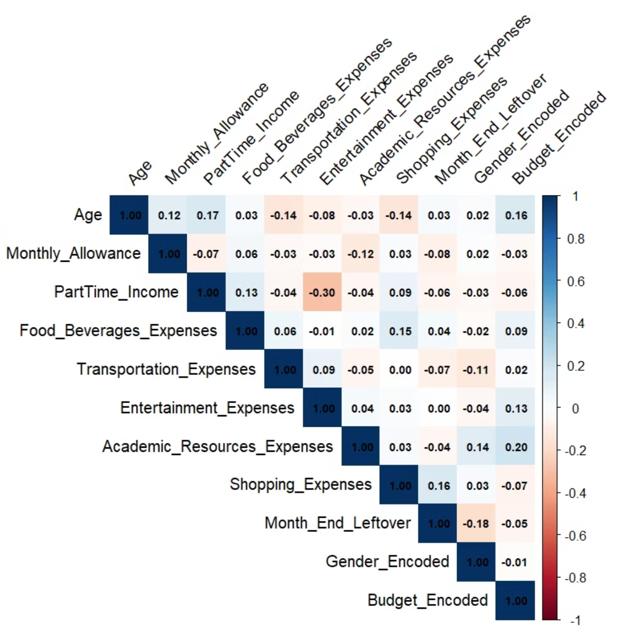
Correlation Heatmap Analysis
The heatmap above displays the correlation coefficients for all numerical variables in the dataset. Darker colors indicate stronger relationships, while lighter colors suggest independence. Key intersections to observe include the relationship between total income availability and discretionary spending habits.

Slide 13
Conclusion & Future Work
Key Conclusion:
Our data analysis unequivocally confirms that budgeting is a pivotal factor strongly correlated with higher month-end savings among students. Implementing a budget demonstrably improves financial stability.
Limitations:
Future Work:
The analysis was conducted on a relatively small and balanced dataset, which may limit generalizability to broader student populations.
Apply advanced predictive models (e.g., linear regression, decision trees) to forecast individual student month-end savings based on their income and spending patterns.
The dataset lacked demographic diversity beyond gender, such as socioeconomic background or geographic location, which could influence financial habits.
Integrate additional qualitative data, such as financial literacy education or access to financial counseling, to gain a more holistic understanding of student financial well-being.

